Slide 1
ICT Computing
Lesson 3:
Computer Software

Slide 2
Objectives
1.3.1: Define “software,” including software types (system vs. application), software interfaces (GUI vs. command-line) and software licenses (commercial vs. open).
1.3.2: Compare the most common computer operating systems (i.e., Windows, Apple, UNIX).
1.3.3: Compare the most common operating systems used in mobile devices (i.e., iOS, Android, Windows Phone).
1.3.4: Compare common types of application software, including browser, e-mail client, word processor, presentation, spreadsheet.
1.3.5: Define the term “cloud computing.”
1.3.6: Describe and use common file-naming conventions.
1.3.7: Identify file types by file name extension, including .doc, .txt, .wav, xls.
1.3.8: Perform file management tasks, including folder creation, file creation, backup, copy, delete, open, save.

Slide 3
System Software
Communicates directly with computer’s circuitry
provides the foundation upon which application software and the computer user can use the system
Includes the computer’s operating system, device drivers and basic system utilities
Device drivers: system software helps peripheral devices like printers or mice communicate with the system and application software
Utility software: helps maintain the computer or operating system
  File manager
  Backup software
  Disk manager

Slide 4
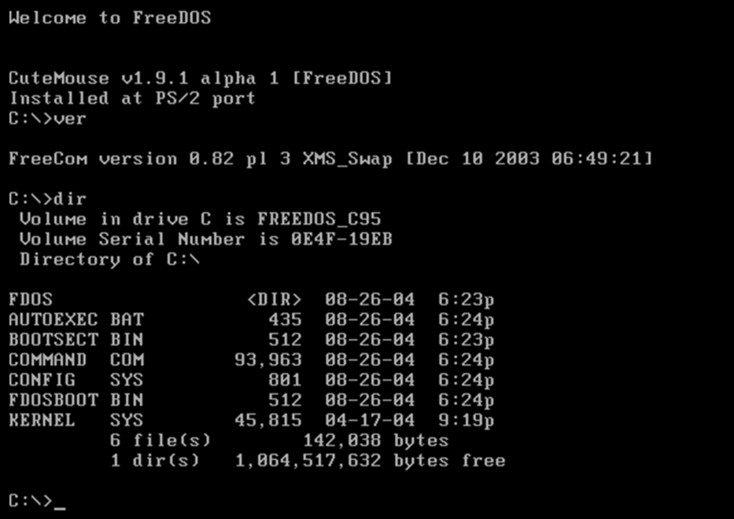
Operating System – Command Line
Have to type instructions

Slide 5
Graphical User Interface (GUI)
Used simply by moving a mouse pointer on the screen and clicking an on icon or file menu selection

Slide 6
Software Licenses
Meant to control the use and distribution of the software within the copyright rights of the software creator.
Commercial: Proprietary software - owned by a company or individual
Must pay for
Cannot modify
Open source: Not owned by any company or individual
user is allowed to modify the software code to suit their needs and is allowed to re-use the software without additional licenses.
Any modifications must be made public
Can NOT charge for original software or any modifications

Slide 7
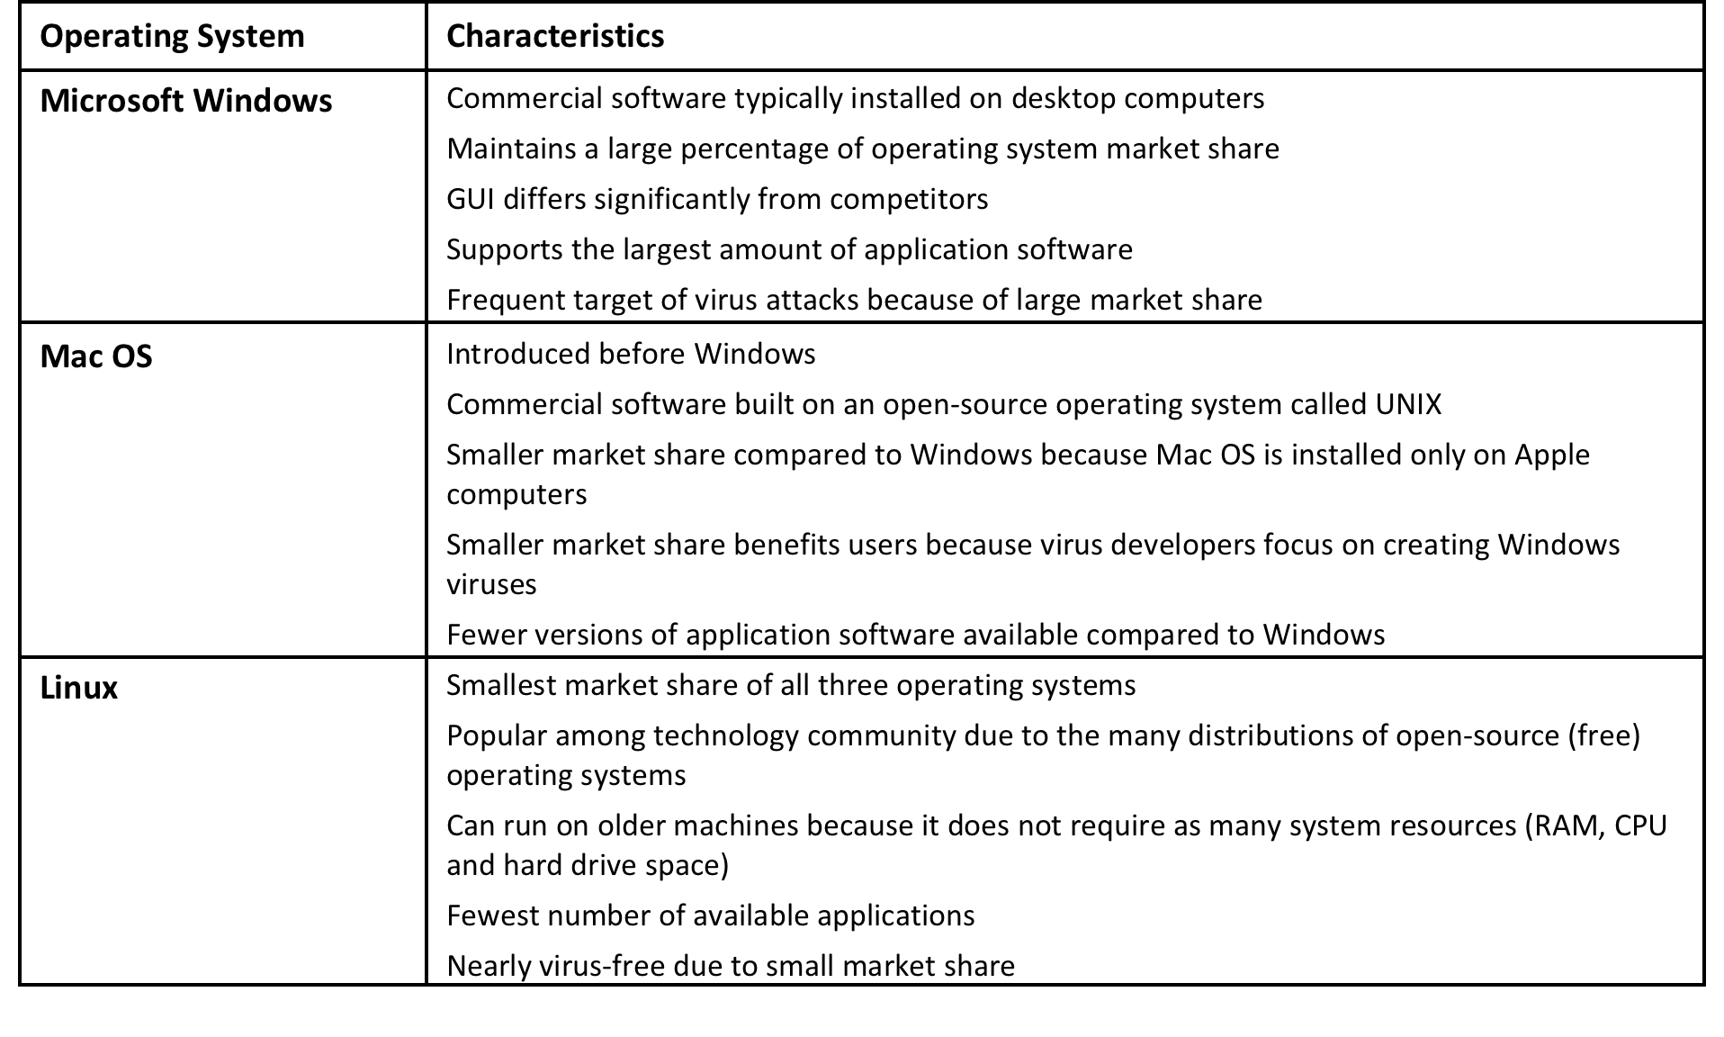
3 Main Computer Operating Systems

Slide 8
3 Main OS’s
Windows
Mac OS
Linux Ubuntu

Slide 9
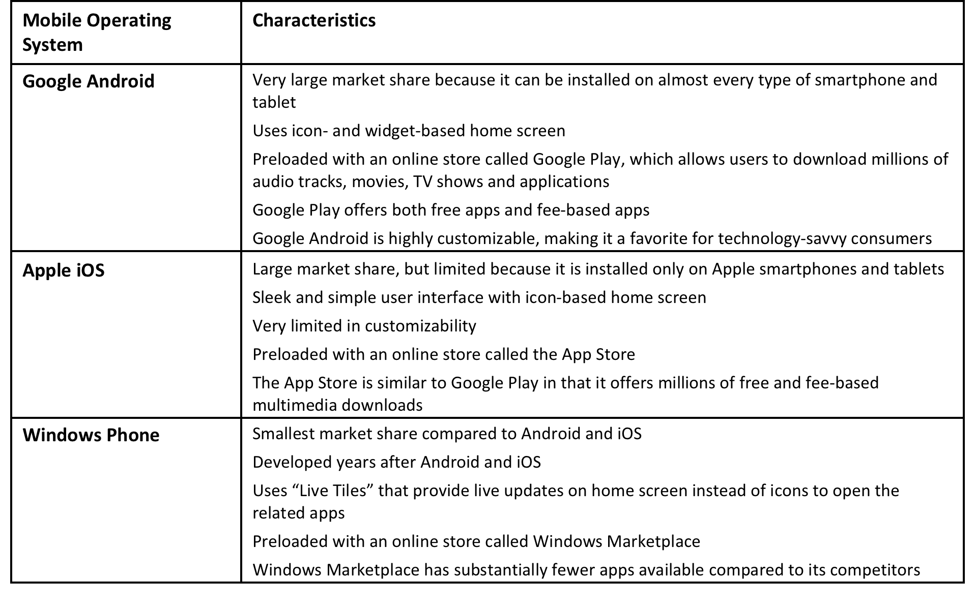
Mobile Operating Systems

Slide 10
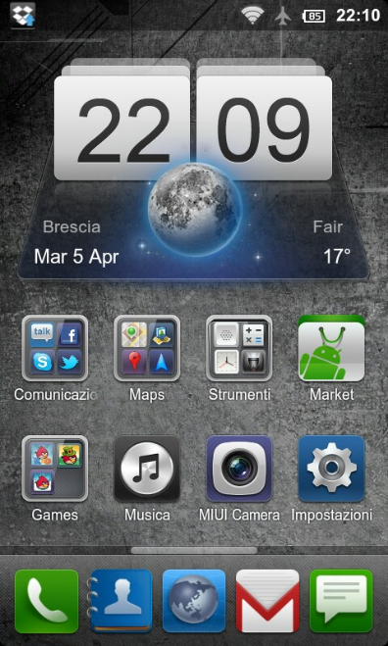
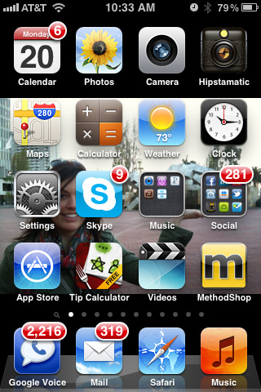
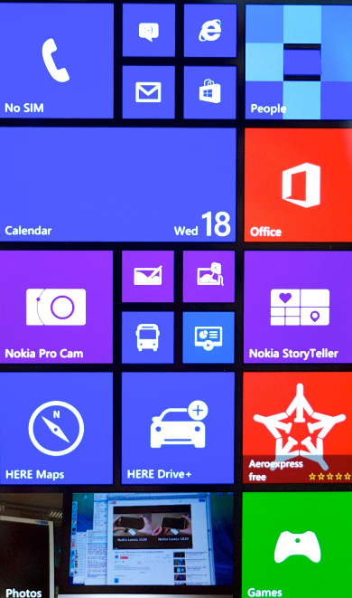
Mobile Operating Systems
Google Android
Apple iOS
Windows Phone

Slide 11
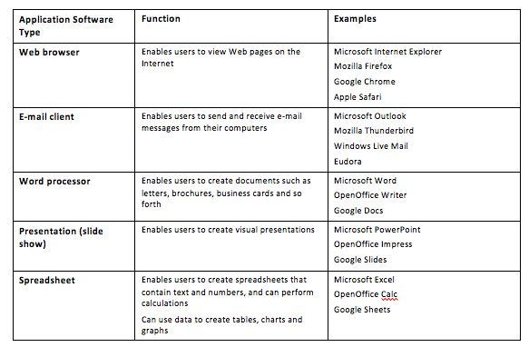
Application Software
Focused on the need of the user to complete a certain task or perhaps a coordinated group of tasks
Can be offered as a single application or of a bundle of related applications like Microsoft Office.

Slide 12
File Management
Naming, organizing and storing files
Here are some guidelines for properly naming files and folders:
Use short, simple file and folder names.
Use file and folder names that describe the content accurately.
Use underscores instead of spaces in file names.
For example: descriptive_essay
Use all lowercase letters in file names.
Avoid using characters such as ! # $ % @ ^ ` ~ + ; = in file and folder names.
Some systems do not allow you to use characters in file and folder names, and will not accept them.

Slide 13
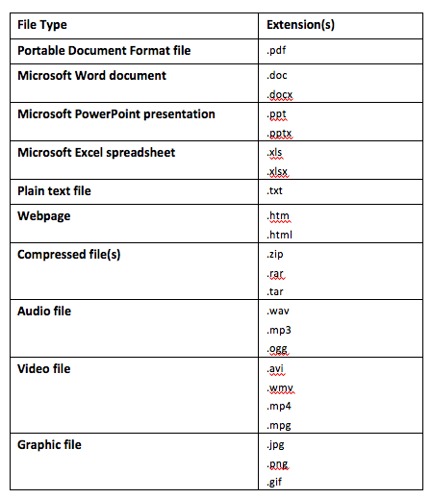
File Extensions
Tell your operating system which application to use to open the file so you can view or edit the file

